Slide 1

Communication Problems

Slide 2








Common Users of UML Diagrams
Product Owner
Business Analyst
Architec t
Operations
Quality Assurance
Developer

Slide 3
Same Thing – Different Language
Suunnittelen ohjelmisto
Ik ontwerp software
म� सॉफ्टवेयर �डजाइन
Ich habe design software
Progettazione software
I design software
소프트웨어 디자인
Дизайн софтуер
Tôi thiết kế phần mềm
Je conçois des logiciels
Diseño software
Я розробки програмного забезпечення

Slide 4

Business?

Slide 5
Technology
Lisp
Python
Smalltalk
C/C++
XSLT
Prolog
DML
F#
JavaScript
C#
DDL
Scala
SOA
Java
SQL
Pascal
TypeScript
VB.NET
Cobol

Slide 6



Design Meetings

Slide 7


Development Methods
Waterfall
Iterative
Plan
Plan
Build
Deploy
Build
Test
Deploy
Test

Slide 8



Methods vs. Models

Slide 9

Formal Tools

Slide 10
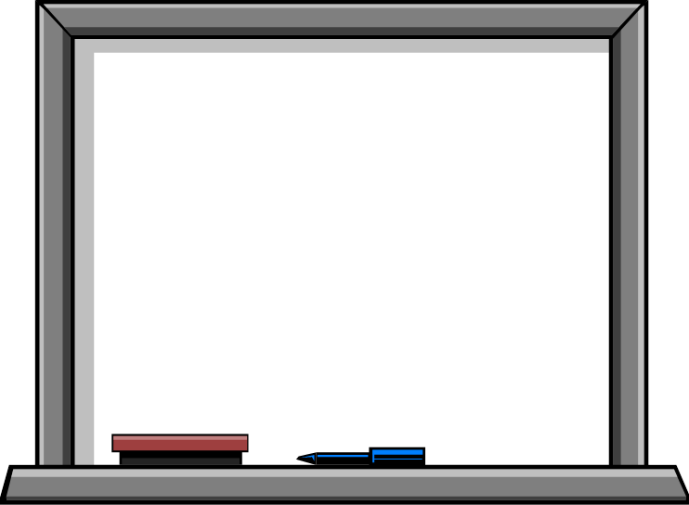

Informal Tools

Slide 11
Introduction
Structural Diagrams
Class Diagram
Component Diagram
Package Diagram
Deployment Diagram

Slide 12



Structural Diagrams

Slide 13
Structural Diagrams
Project Vocabulary
Structural Relationships
Architectural Diagrams

Slide 14
Class Diagram
Vocabulary
Relationships
BillPayer
SchedulePayment() ImmediatePayment()
<<Future>> Allow Multiple Accounts for a Payment
Payee
Customer
* *
Account Holder
Account
*
1
“Boxes and Lines”
1
*
Address
CheckingAccount
SavingAccount
minimumBalance
interestRate

Slide 15


Common Users of Class Diagrams
Product Owner
Business Analyst
Architec t
Operations
Quality Assurance
Developer

Slide 16


Classes and Interfaces
Class
Represents an Entity (Noun)
Attributes
Operations
Omit Details if not required
Interface
Account
balance Deposit()
Withdrawl()
Customer
<<Interface>> IAccount
Deposit() Withdrawl()

Slide 17

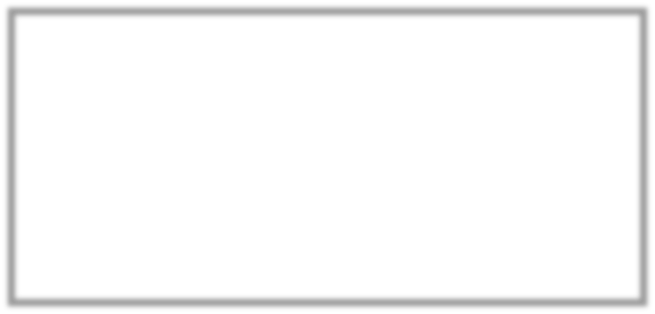
Implementation and Inheritance
Implement Interface
▪
Inheritance (“Is A”)
Abstract Class
Concrete Class
<<Interface>> IAccount
Deposit() Withdrawl()
Account
CheckingAccount
SavingAccount
minimumBalance
interestRate

Slide 18



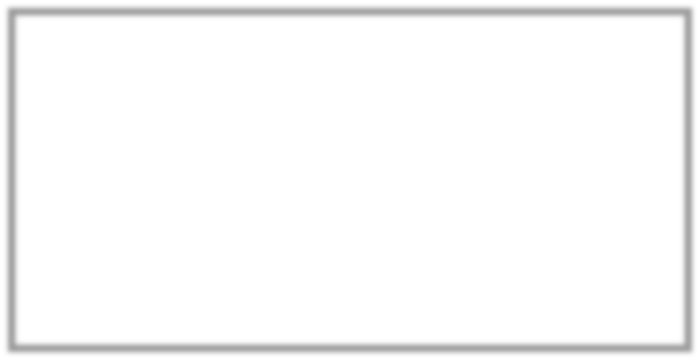
Relationships
Basic (“Has A”)
Multiplicity
Aggregation
Whole - Part
Composition
Ownership
Uses
Customer
Account
*
*
Payee
Customer
*
1
1
*
Address
BillPayer
SchedulePayment() ImmediatePayment()
Payee
Account

Slide 19
Basic Class Diagram
BillPayer
SchedulePayment() ImmediatePayment()
<<Future>> Allow Multiple Accounts for a Payment
Payee
Customer
*
*
Account
*
1
Account Holder
1
*
Address
CheckingAccount
SavingAccount
minimumBalance
interestRate

Slide 20
Component Diagram
Identify Interfaces
Define replaceable parts
Online Bill Payment
Configuration
Payments
Payment Processor
Logging
Logger
Instrumentation

Slide 21

Common Users of Component Diagrams
Business Analyst
Product Owner
Architec t
Operations
Quality Assurance
Developer

Slide 22


Basic Component
Component
Interfaces
Realized
Required
Online Bill Payer
Payment
Payee
Online Bill Payer
Account

Slide 23


Connected Components
Loosely Connected
Tightly Connected
Instrumentation
Payment
Payee
Investment Service
Online Bill Payer
Account

Slide 24
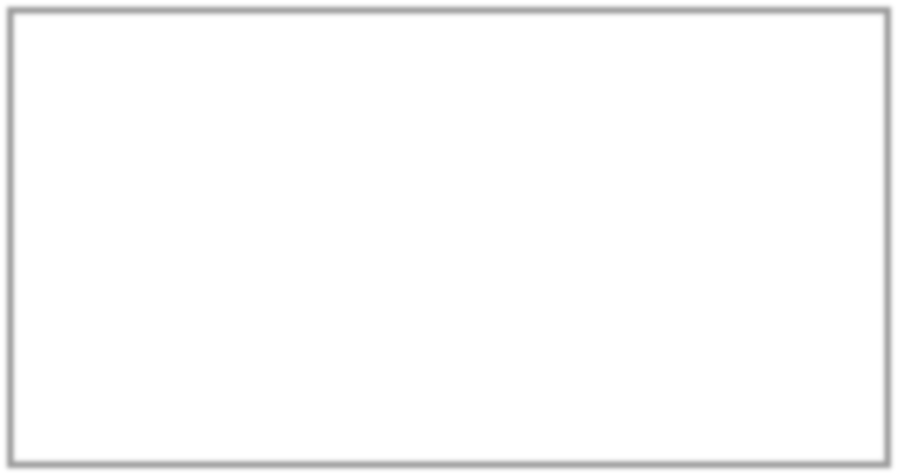
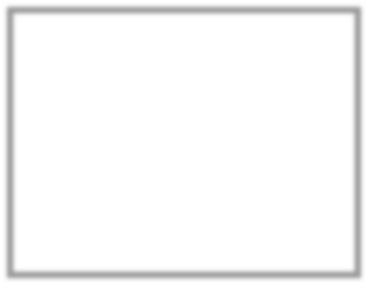
Basic Component Diagram
Online Bill Payment
Configuration
Payments
Payment Processor
Logging
Logger
Instrumentation

Slide 25
Package Diagram
Logical Container
Support Large Models
WebClient
Logging
OnlineBillPayer
ChildSavingsPlan
BirthdayBonus
InvestmentServices

Slide 26
Common Users of Package Diagrams
Business Analyst
Product Owner
Architec t
Operations
Quality Assurance
Developer

Slide 27
Simple Packages
Basic
Showing (relevant) elements
Can Contain
Classes
Interfaces
Components
Nodes
Diagrams
Packages
Etc.
AccountServices
OnlineBillPayer
ChildSavingsPlan
InvestmentServices

Slide 28

Nested Packages
Contained Packages
Maximum 2 or 3 deep
Packages define scope
Qualified Names
Use double colon - ::
RateCalculator
IncomeVerification
AccountServices::LoanProcessing::RateCalculator

Slide 29
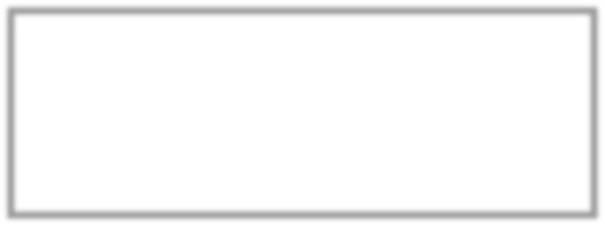
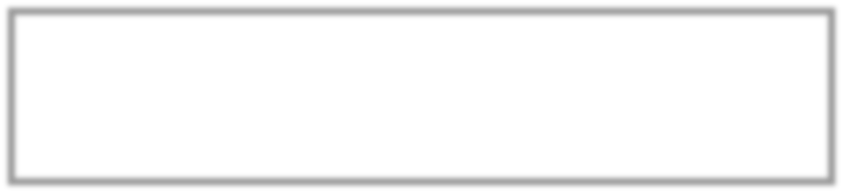
Basic Package Diagram
Web Client
Logging
Online Bill Payer
ChildSavingsPlan
BirthdayBonus
Investment Services

Slide 30
Deployment Diagram
Map Components to Physical Systems
View Special Devices
Visualize Hardware and Network Dependencies
Browser
Internet
DB Server
Web Server
Off
App Server
Loan
icer PC
Branch Server
Scanner

Slide 31


Common Users of Deployment Diagrams
Architec t
Product Owner
Business Analyst
Operations
Quality Assurance
Developer

Slide 32

Nodes
Processors
Cubes
Stereotyped
Detailed
Devices
Networks
Specialty
<<processor>> Database Server
<<processor>> 2-* Application Server
Deploys: AccountServices Logging
Web Server
Internet
Scanner

Slide 33




Basic Deployment Diagram
Browser
Internet
DB Server
Web Server
Off
Loan
App Server
icer PC
Branch Server
Scanner

